Slide 1
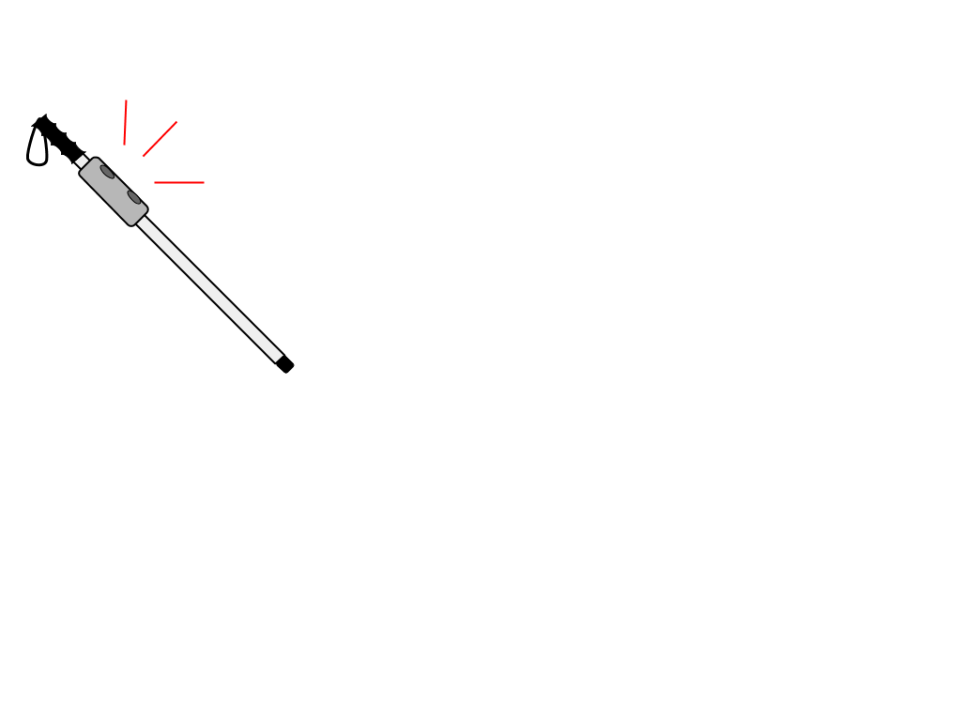
Smart Cane
Final Presentation
CSCE 483/Spring 2020
Arthur Helmen, Baltazar Guerra, Jonathan Williams,
Matthew Giuffrida, Shawn Popal

Slide 2
Problem Statement

Slide 3
Problem Background
Navigation is something we take for granted, but can be a major concern for the blind and visually impaired.
One of the most common, and widely recognized, tools used by the blind community to address this issue is a “white cane.”
Our project is to upgrade a white cane with additional functionality - namely, directions provided through haptic/audio feedback, integration with smartphones, in-building navigation and orientation, and quick access to emergency services

Slide 4
Needs Statement
There are obstacles that a traditional white cane would be unable to, or unlikely to, detect.
Orientation inside a room or building can be difficult for the visually impaired if there are not identifiable changes in the texture of the floor.

Slide 5
Goal and Objectives
-Provide robust, consistent detection of obstacles in the path of a user
- Give clear directions to the user that leverage the accessible-friendly features of campus
-Provide orientation and directions to the user inside of buildings on request
-Allow the user to quickly contact emergency services

Slide 6
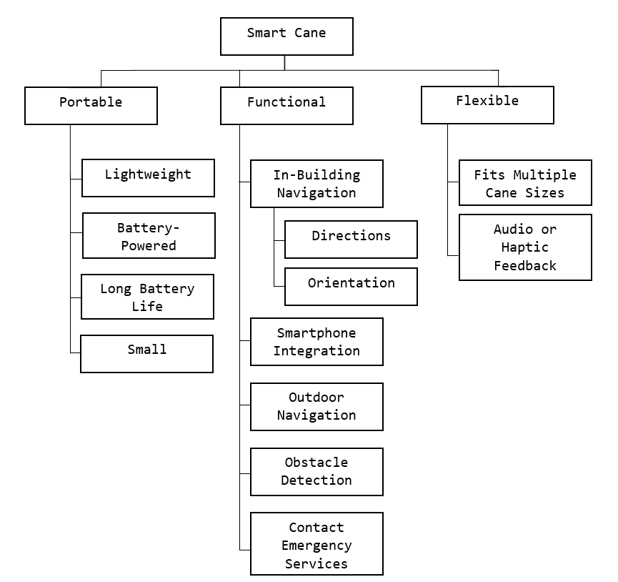
Requirements: Objective Tree

Slide 7
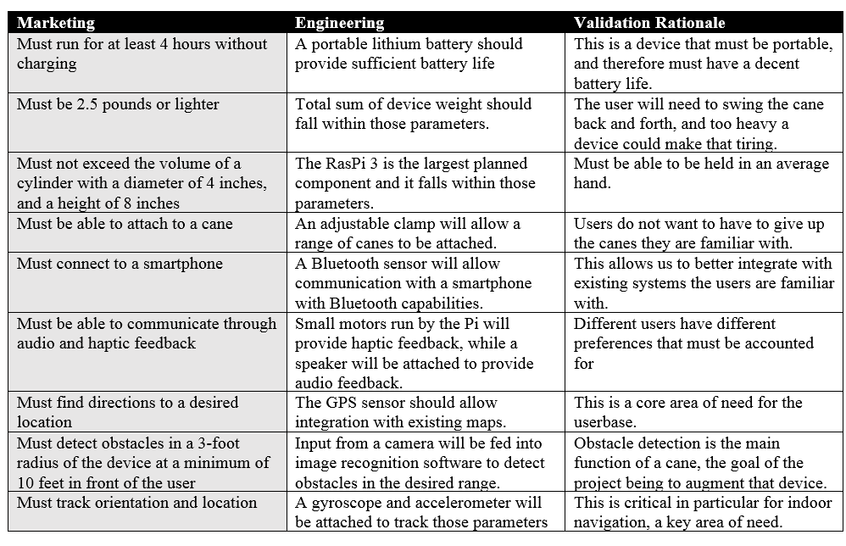
Requirements

Slide 8
System Description

Slide 9
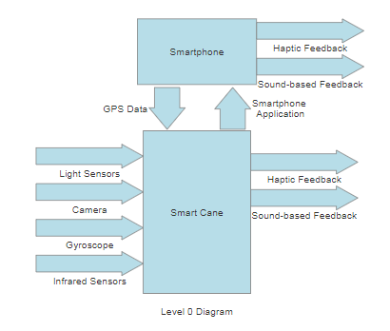
Design Specifications (Level 0)
4 Standalone Inputs
Data from light sensors
Data from camera
Data from the internal gyroscope
Data from the infrared sensors
1 Optional Input from Smartphone
GPS data
2 outputs
Haptic Feedback
Sound-based Feedback
Smartphone can mirror these outputs, but is not necessary
Human Input

Slide 10
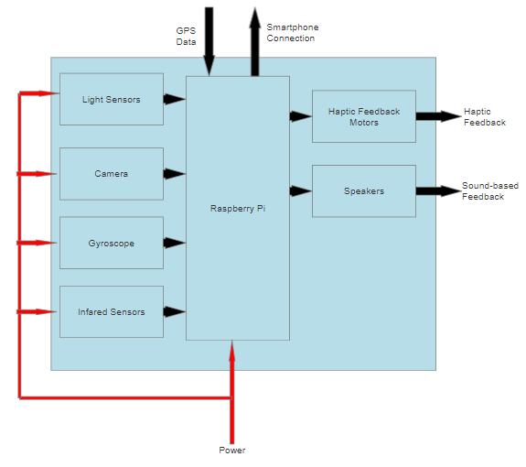
Design Specifications (Level 1)
Internal modules and their interactions within the cane itself
Raspberry Pi acts as central brain, processing all incoming data from the sensors and sending the appropriate responses through the haptic feedback motors and speakers
Smartphone connection brings in additional GPS data for map tracking and navigation
Human Input

Slide 11
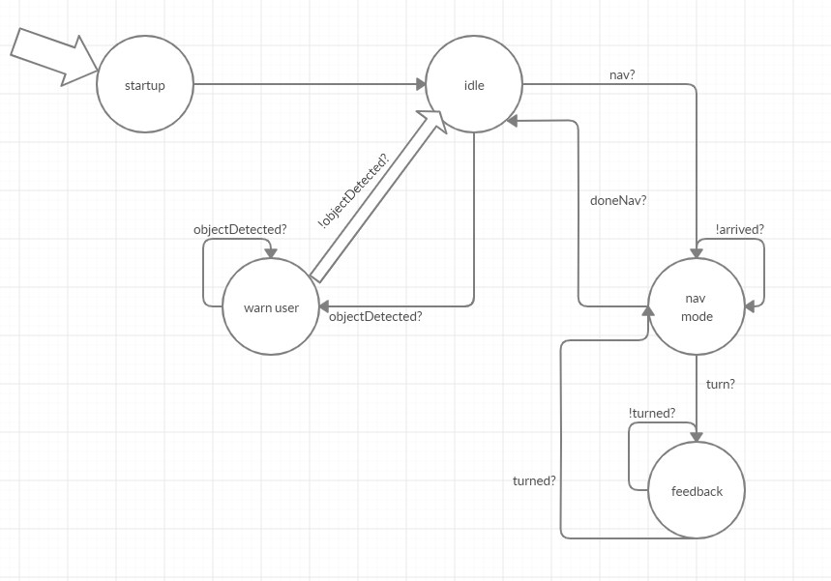
Design Specifications (FSM)
Idle - always checking for incoming objects
Nav Mode - Gives feedback based on directions

Slide 12
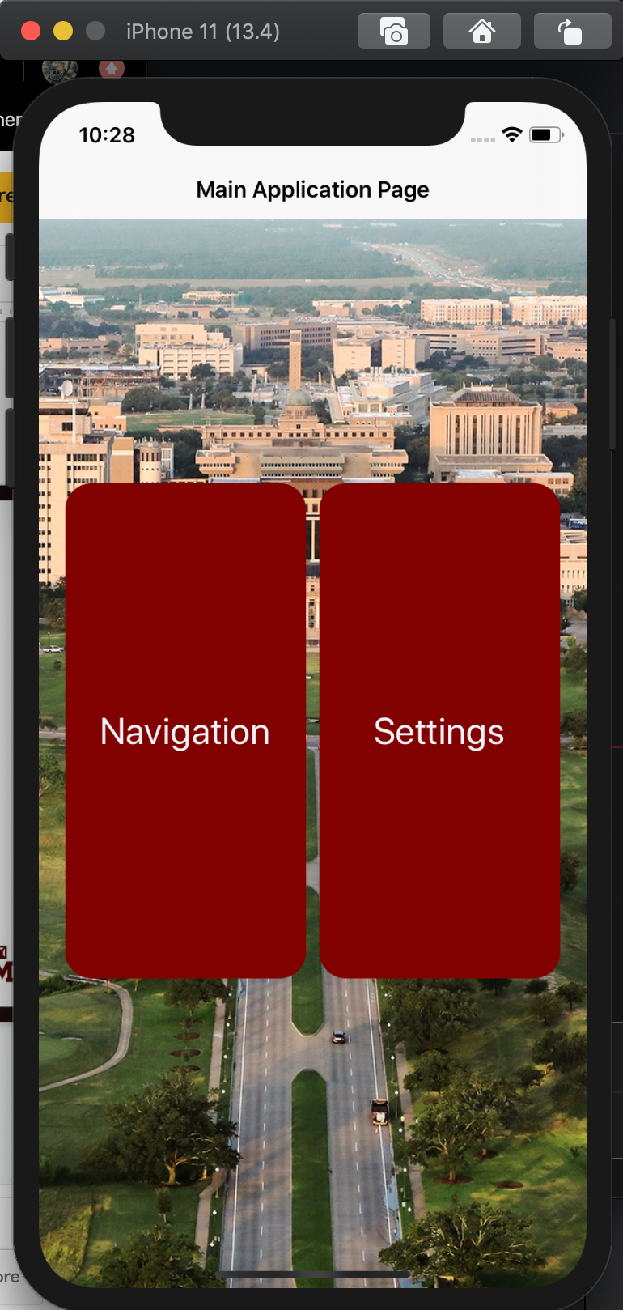
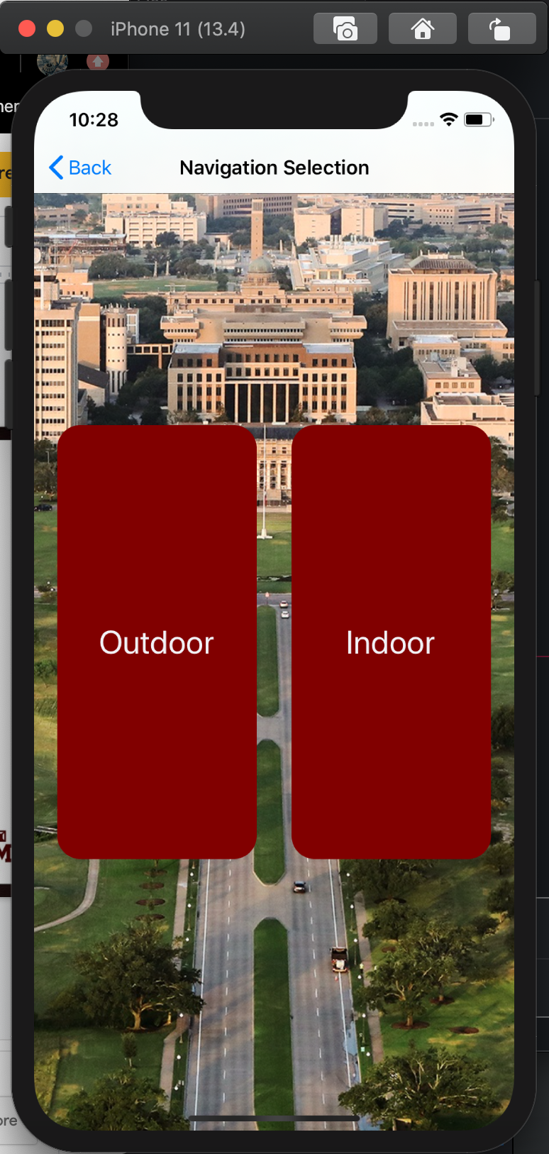
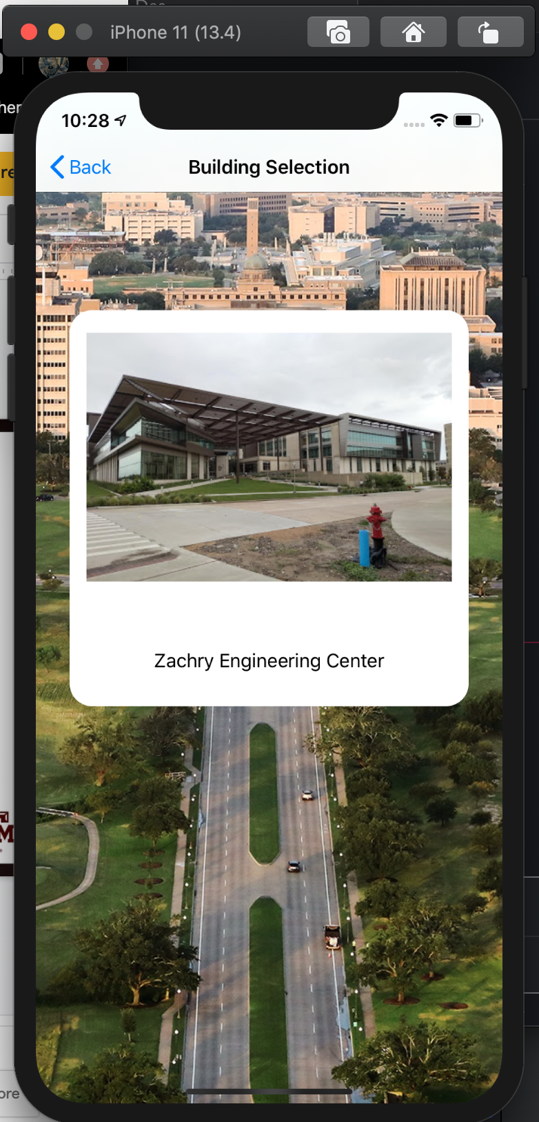
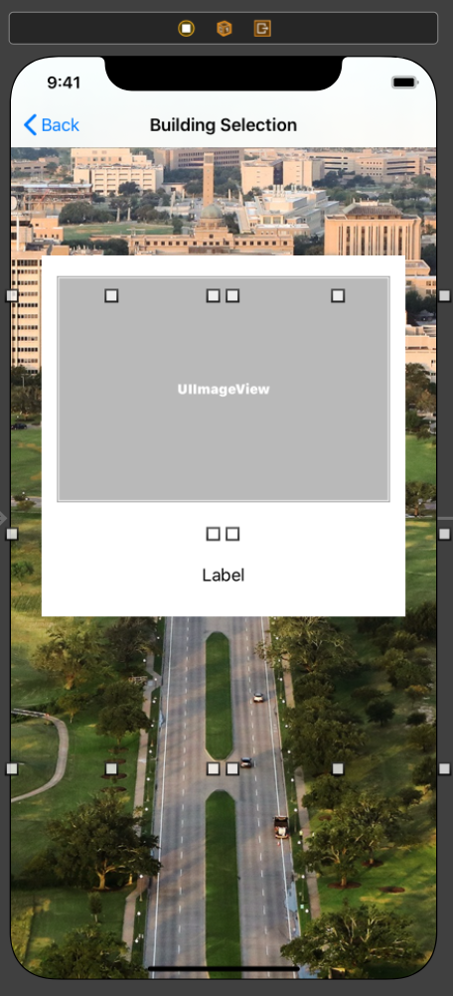
iOS Application - Outdoor

Slide 13
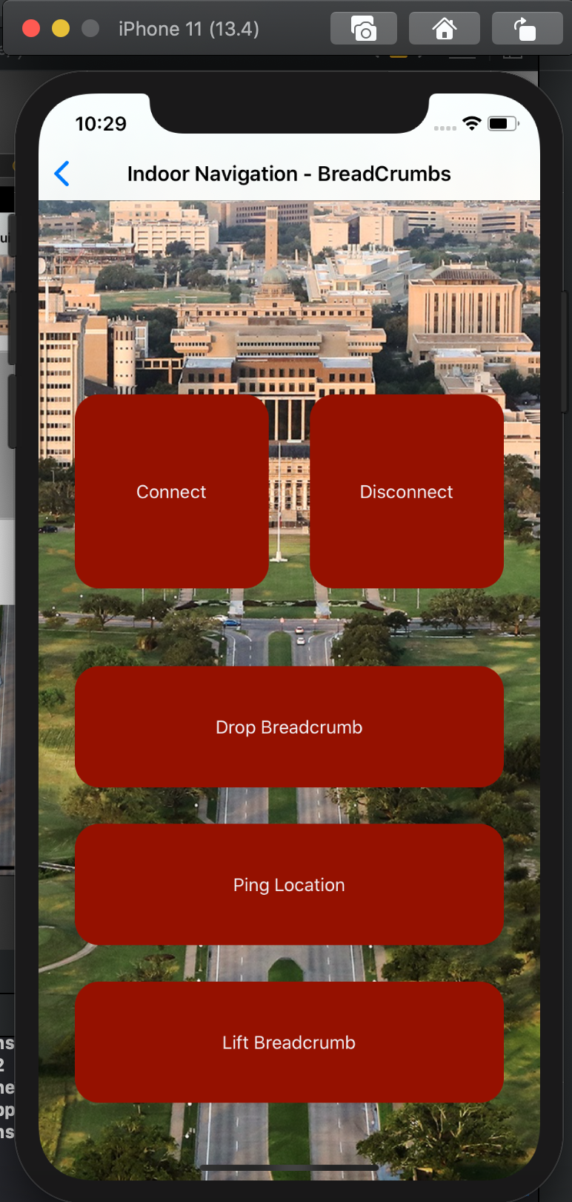
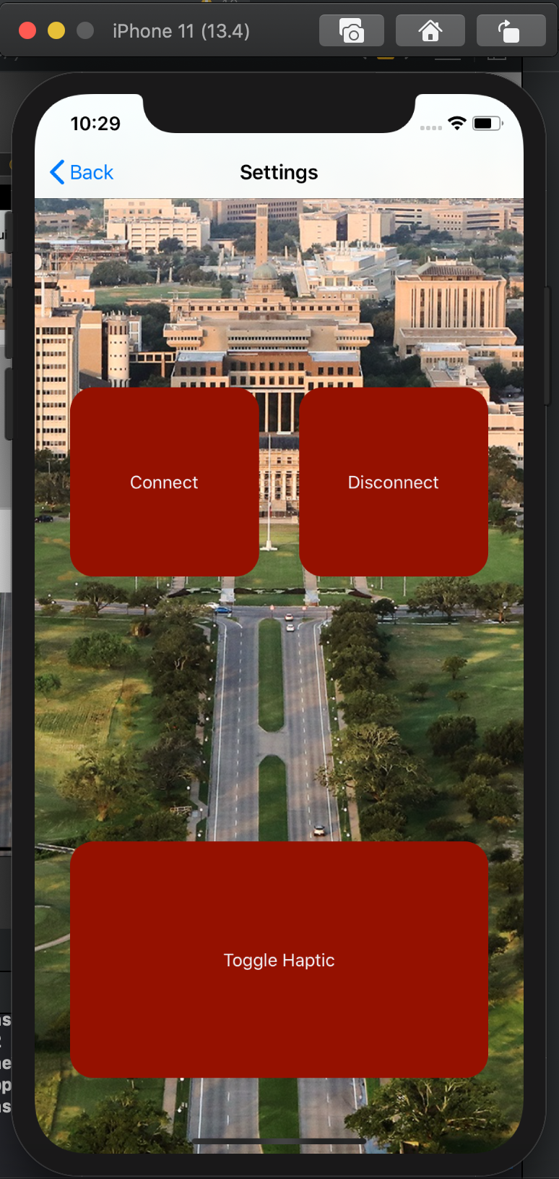
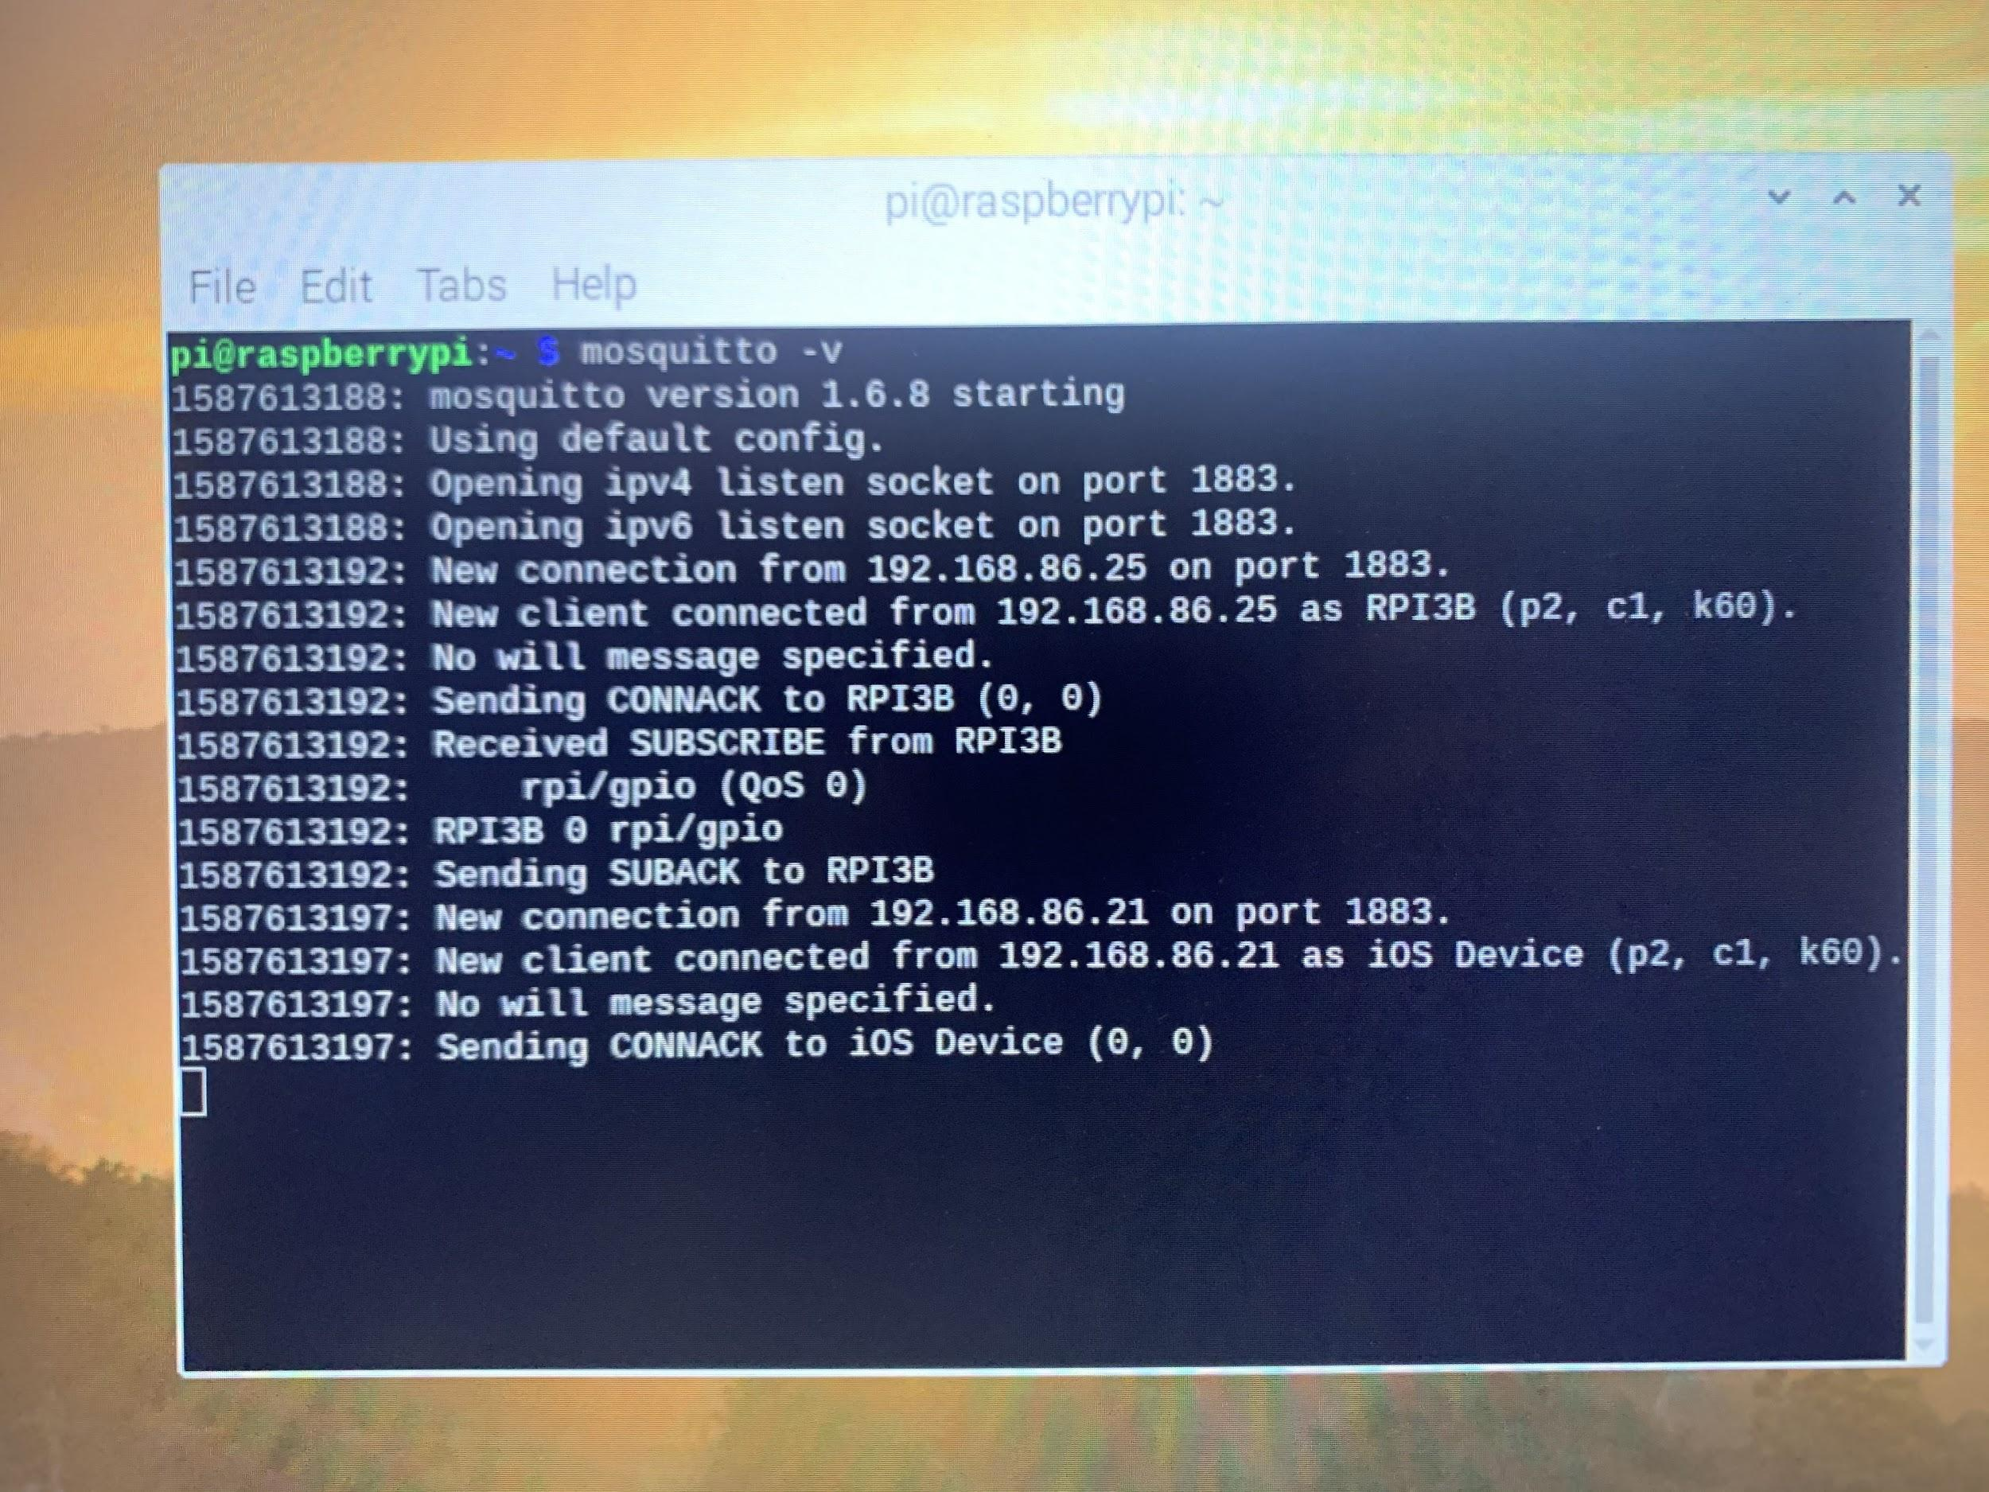
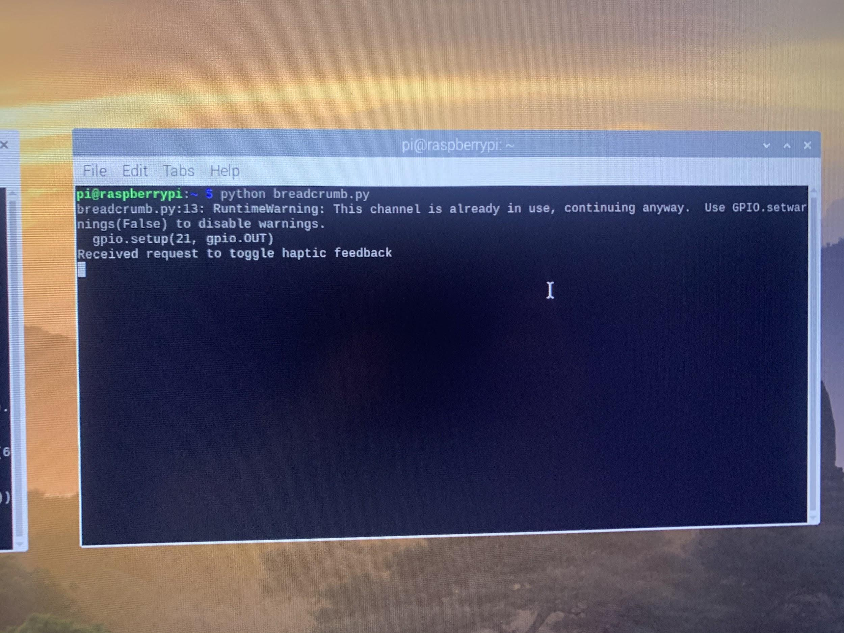
iOS Application - Indoor/Settings

Slide 14
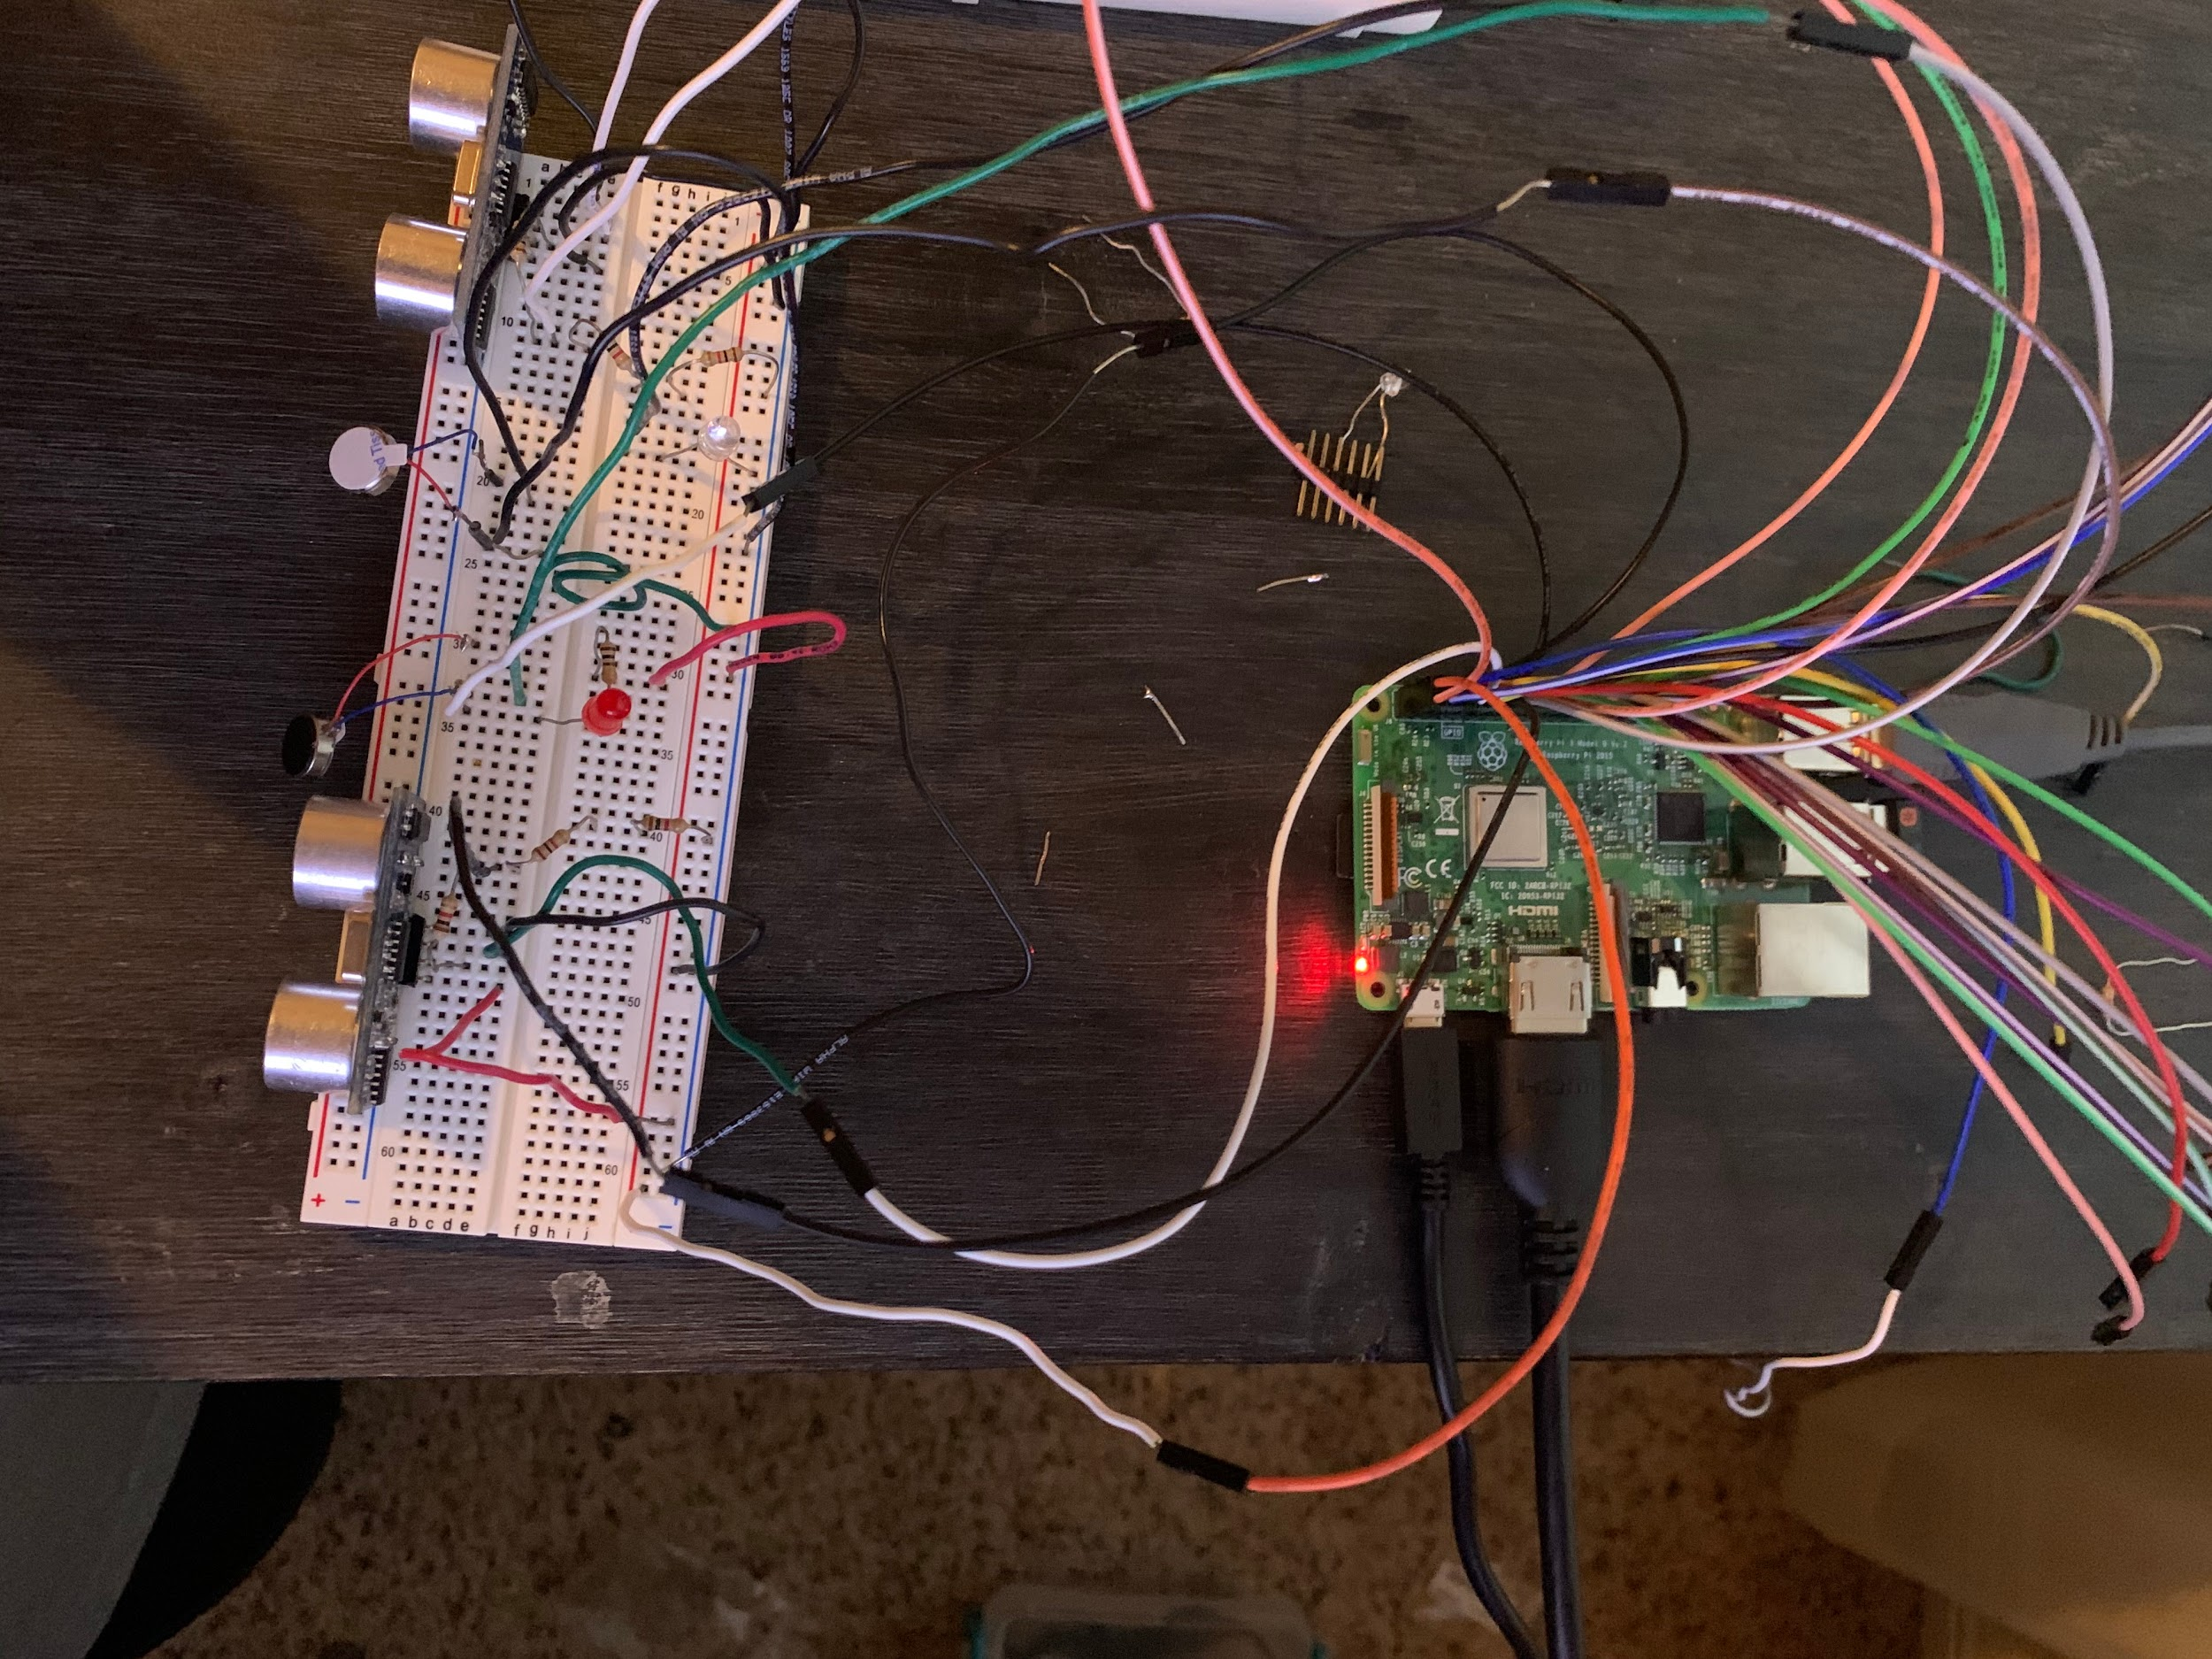
Object Detection

Slide 15
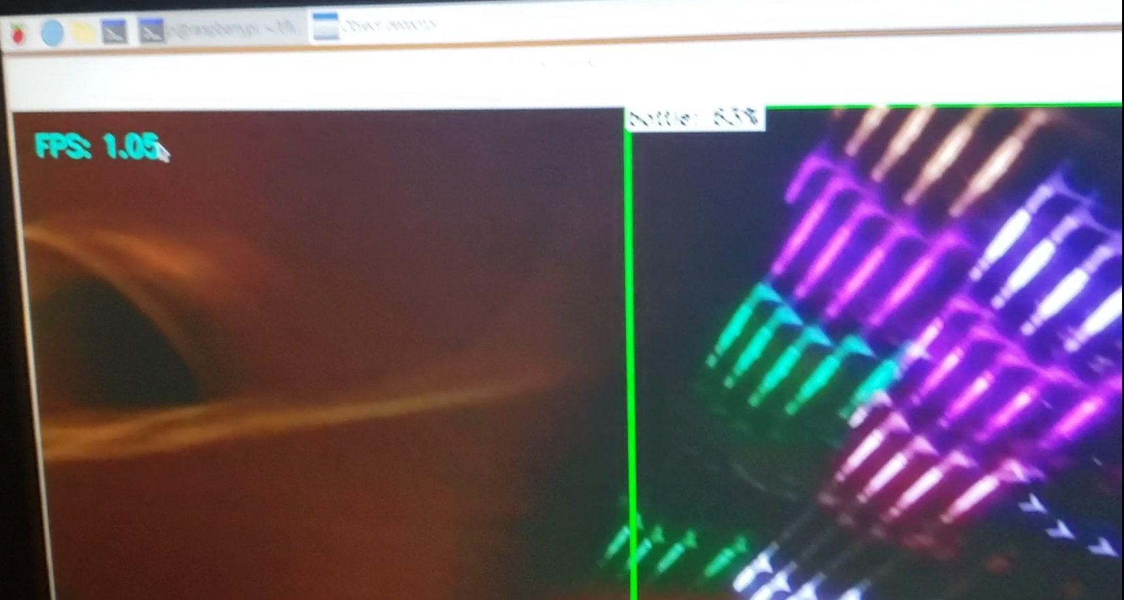
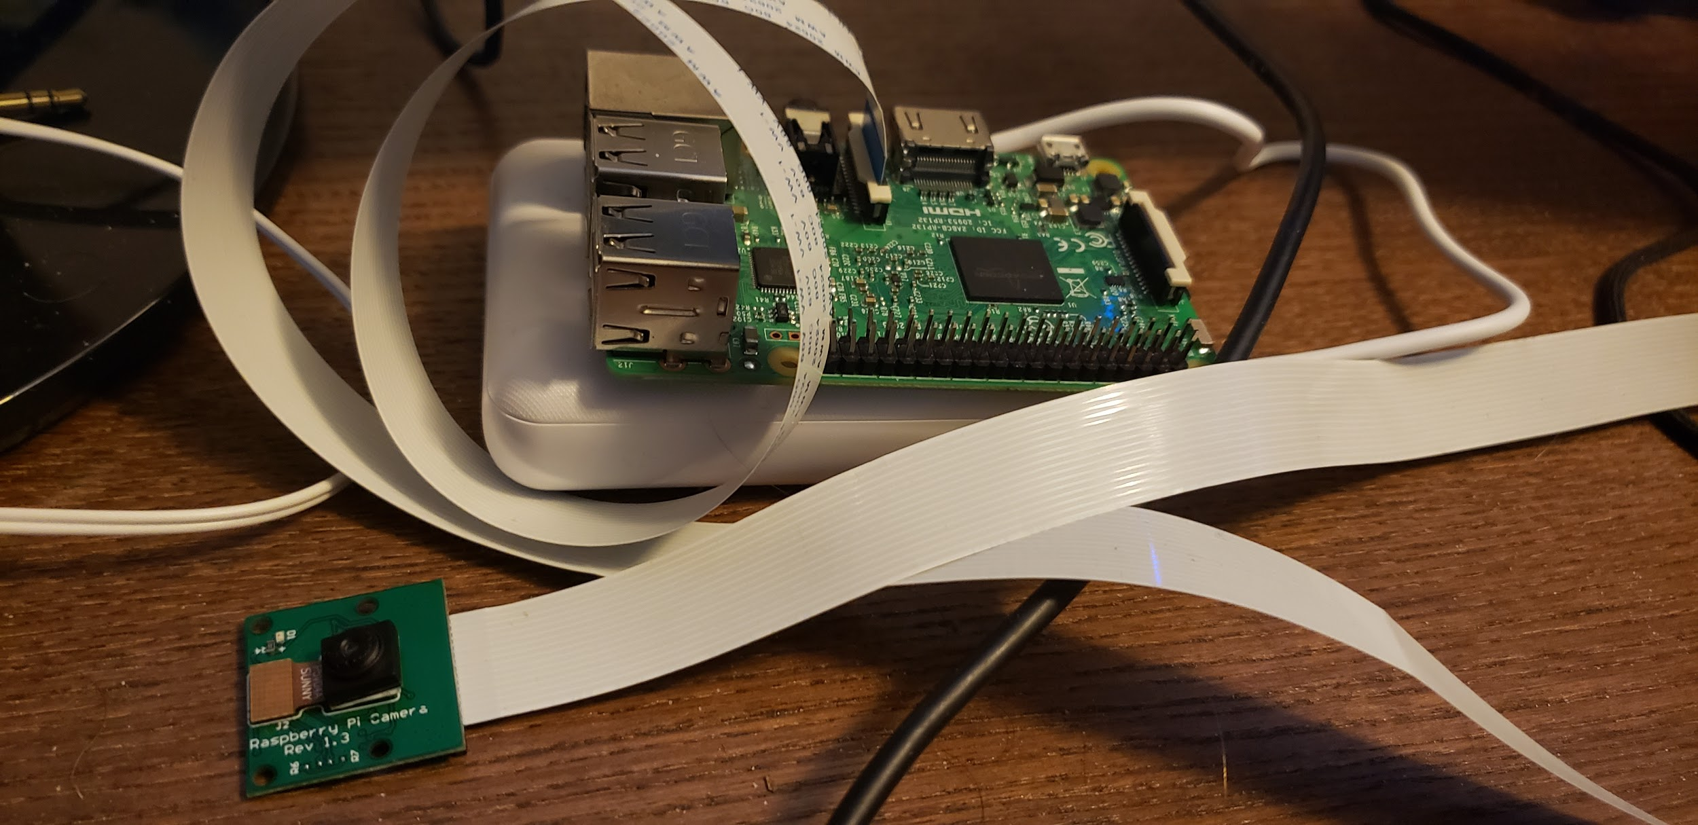
Object Identification

Slide 16
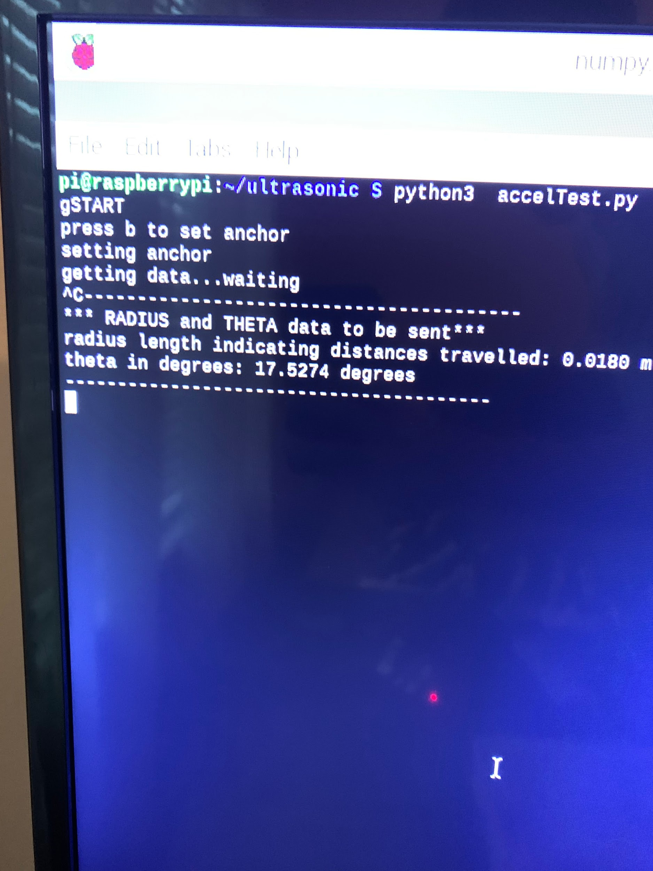
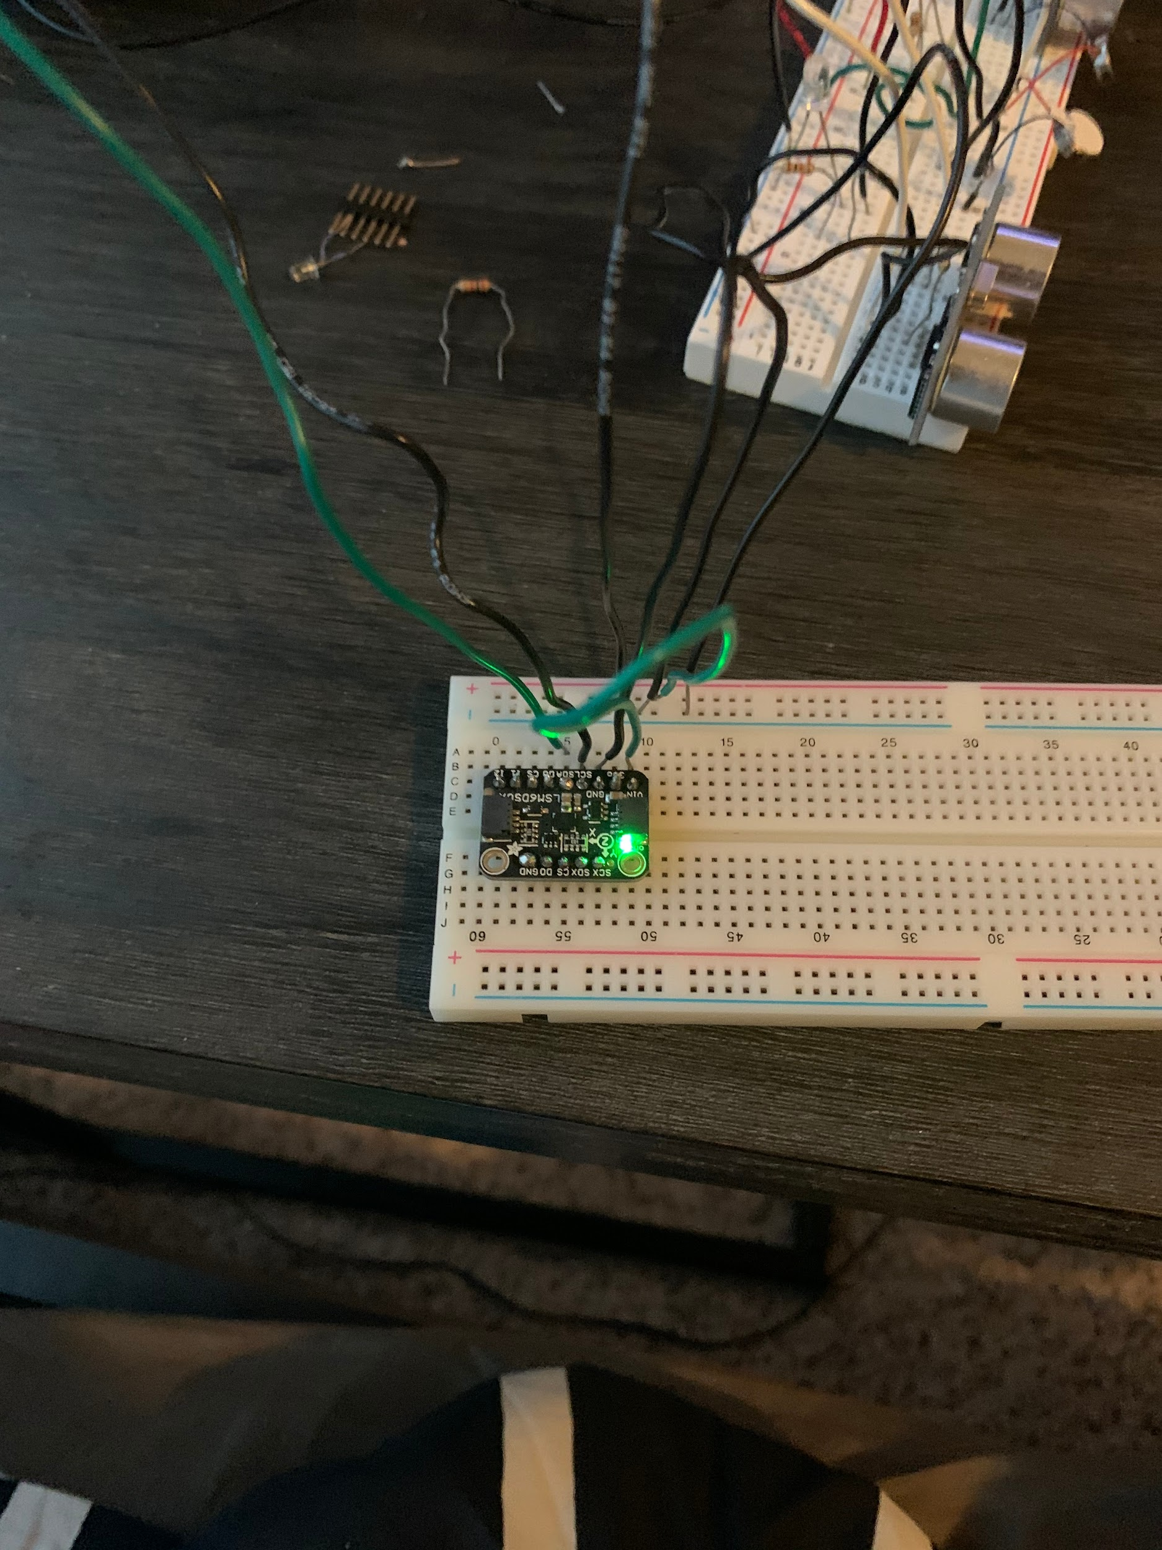
Indoor Navigation Sensor

Slide 17
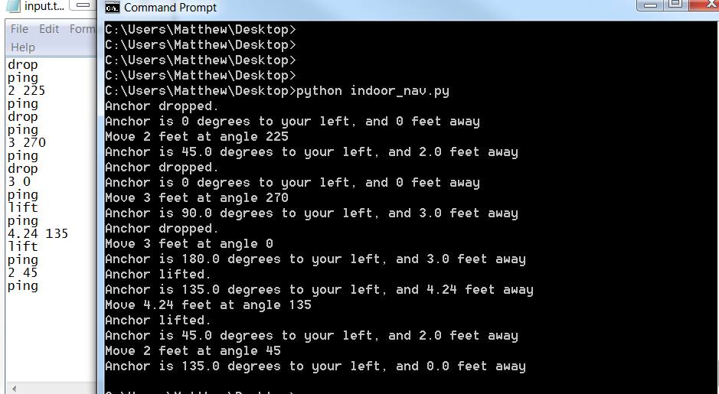
Indoor Navigation Software

Slide 18
Design Validation

Slide 19
Design Validation Plan
-Obstacle Detection
System (consisting of RaspberryPi, ultrasonic sensors, haptic motors) must be able to use the ultrasonic sensors to consistently detect objects in the users path
If an object is found, this information is communicated using haptic motors
In order to test that this function is working correctly, obstacles (like a chair or a box) will be placed in the sensor’s path, if the device can consistently warn the user within our intended detection radius, it can be categorized as functional and the components can be permanently added onto the device.
-User Navigation
the user must be able to use the application to select a location (for our purpose we are using on-campus locations) by swiping through possible locations**** and then they are led to that location with the app, which will send navigational cues to the pi
We can test by selecting a location, and having the navigation directions accurately communicated using the cues, then this functionality works.

Slide 20
Design Validation Plan
-Indoor navigation (breadcrumb system)
The gyroscopic sensor, attached to the Pi, and the app, must work together to allow a user to set “anchors”, that the user can then be lead back to using audio or vibration cues. Multiple anchors should be able to be set, and the user is lead to each anchor in the reverse order that they were set.
To ensure the breadcrumb system is working correctly, we will set an anchor point, and make sure the distance from the point, and the angle to the point are accurate. Then make sure the code to process this information can accurately calculate how to navigate the user back.

Slide 21
Design Demonstration

Slide 22
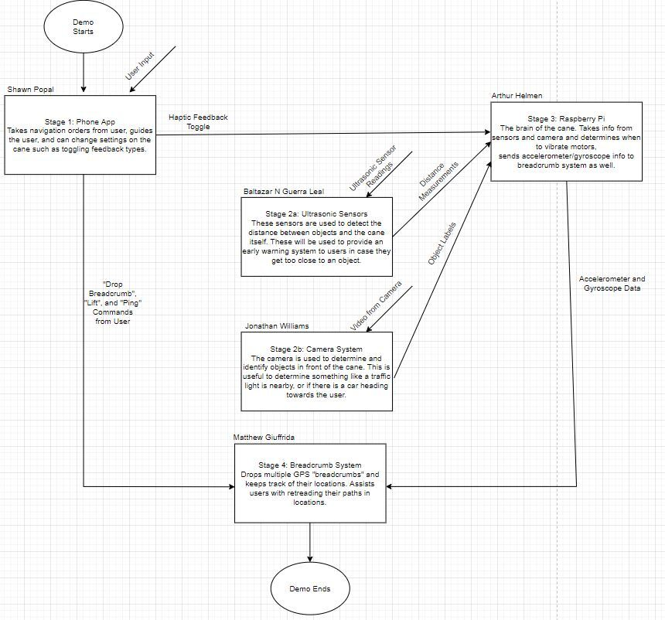

Slide 23
Design Demonstration Plan
-With the current systems we have, an ideal demo would include:
A person screen sharing the application, showing the features we have setup
Our obstacle detection system detecting objects within our range, using the ultrasonic sensors and camera
Our indoor navigation system being shown able to set an anchor point, track a user’s distance from the point, as well as the angle they need to face., and software showing that the user can be guided back to that point.

Slide 24
SHOW LIVE DEMO

Slide 25
Project Management
Schedule of Tasks
Economic Analysis
Itemized Budget
Societal, Safety and Environmental Analysis
Engineering Standards

Slide 26
Project Management
Baltazar Guerra: Team leader, system and software design.
Shawn Popal: Software design, app development, finance and purchases.
Arthur Helmen: Hardware and circuitry design, component testing.
Matthew Giuffrida: Hardware and software design, prototype testing.
Jonathan Williams: Software design and prototype testing.

Slide 27
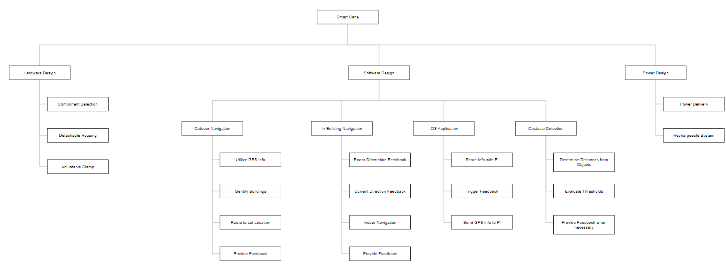
Project Management

Slide 28
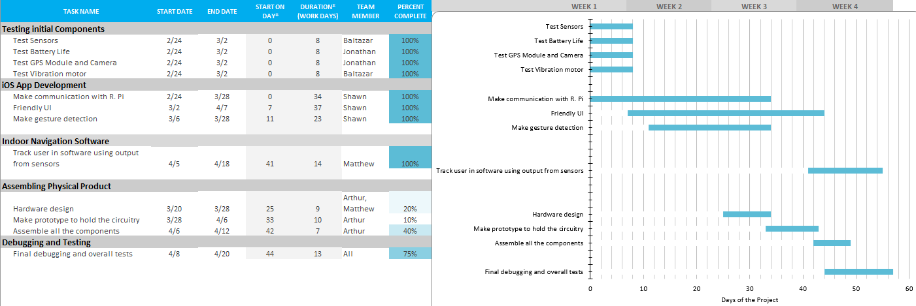
Schedule of Tasks

Slide 29
Economic Analysis
Current Market Solutions are very pricey and do not satisfy every requirement
In-Building Navigation
Outdoor Navigation
Unique Solution for the Texas A&M Campus
Modular Solution
Improve functionality while reducing price significantly
Providing solutions to key issues specific to the Campus
Parts are readily available
No maintenance required

Slide 30
Itemized Budget
Item | Quantity | Estimated Cost
Raspberry Pi 3 B | 1 | $45
Ultrasonic Sensors | 3 | $6
Gyroscope | 1 | $15
Camera | 2 | $60
Vibration Motor | 3 | $5
Speaker | 1 | $5
Battery | 1 | $39
White Cane | 1 | $15
GPS Module | 1 | $37
Total | 19 | $227

Slide 31
Societal, Safety and Environmental Analysis
Goal of this product is to aid the lives of those who are visually impaired, hopefully allowing them to navigate through the Texas A&M campus as seamlessly as possible
Safety naturally is the number one concern
Crosswalks, Buses, Utility Vehicles, People
Many unpredictable variables on a day to day basis
100% electric power system
Rechargeable Battery

Slide 32
Future Plan

Slide 33
Future Plan
Future Extensions:
Adding speakers as a way of feedback.
Get better hardware for machine learning (Raspberry Pi 3 limited the FPS by the camera)
Better vibrating motors that have sturdier wires.
Under optimal conditions, we would have all subsystems together and better calibrated.
Skills needed
Knowledge of Python to code on the Raspberry Pi 3
Practice on working with hardware components
Knowledge of coding in XCode for the iOS App
Experience using API’s for object detection

Slide 34
ACKNOWLEDGEMENTS
Justin Romack (Student Disability Services, TAMU), justinr@disability.tamu.edu

Slide 35
REFERENCES
[1] UltraCane, “About the UltraCane,” http://www.ultracane.com/about_the_ultraca ne, (19 July 2014)
[2] R. K. Megalingam, A. Nambissan, A. Thambi, A. Gopinath, and M. Nandakumar, “Sound and touch based smart cane: Better walking experience for visually challenged,” 2015.
[3] M. Aggravi, D. Prattichizzo, G. Salvietti, “Haptic Assistive Bracelets for Blind Skier
Guidance” , AH ‘16: Proceedings of the 7th Augmented Human International Conference 2016.
[4] M. Brock, P. O. Kirstensson, “ Supporting Blind Navigation Using Depth Sensing and Sonification”, UbiComp ‘13 Adjunct: Proceedings of the 2013 ACM Conference on Pervasive and Ubiquitous Computing Adjunct Publication.
[5] V. Kulyukin, C. Gharpure, J Nicholson, and S. Pavithran. Rfid in robotassisted indoor navigation for the visually impaired. 2004 IEEE/RSJ International Conference on Intelligent Robots and Systems, 2004.

